Slide 1
Animal Classification using Machine Learning
Tamaghna Sarkar Intern at Unified Mentor Pvt. Ltd.
From 01.07.2025 to 01.08.2025

Slide 2
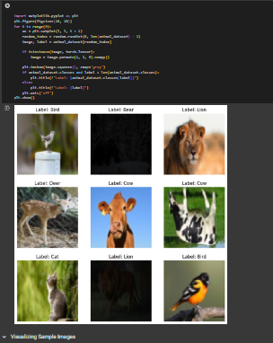
Introduction & Dataset
Goal: To develop a machine learning model that can classify animals into various types based on a set of biological features.
Dataset Overview:
The dataset includes features like number of legs, presence of hair or feathers, milk production, ability to fly, aquatic or terrestrial nature, and more.
It is structured and categorical, making it suitable for supervised classification tasks.
Motivation: Classification of animals based on their physical and biological traits helps in zoological studies, educational tools, and AI-based taxonomy models.

Slide 3
Data Preprocessing & Analysis
Key Steps:
Categorical features were encoded for machine learning compatibility.
Checked for duplicate or missing data and ensured dataset cleanliness.
Applied exploratory data analysis to understand feature distribution and class imbalance.
Insights:
Visualizations showed strong relationships between features like hair, feathers, and the animal type.
Certain traits (e.g., ability to fly or lay eggs) had high predictive power.

Slide 4
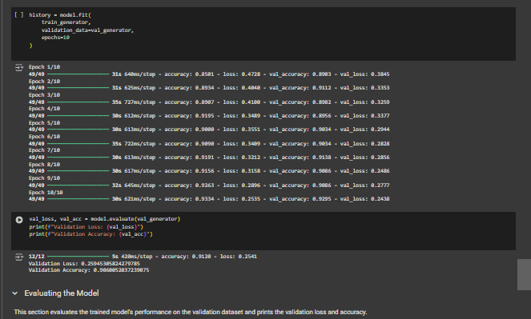
Model Building & Performance
Models Used:
Decision Tree
K-Nearest Neighbors (KNN)
Random Forest
Logistic Regression
Evaluation Metrics:
Accuracy and confusion matrix were used to evaluate model performance.
Decision Tree showed the highest accuracy of ~97%, making it the top choice.
The image shows modeltraining,
validation loss and accuracy.

Slide 5
Conclusion
Conclusion:
The classification models effectively predicted animal types with high accuracy.
Decision Tree models provided both strong performance and interpretability.
The project demonstrates how ML can simplify and automate biological classification.
I express my heartfelt gratitude to Unified Mentor Pvt. Ltd. for allowing me to work on this engaging and educational project.

